Slide 1
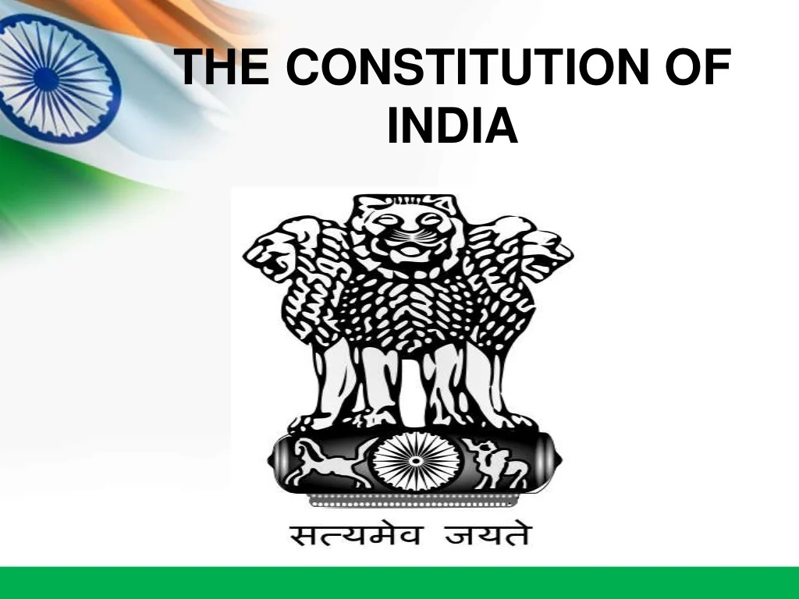

Slide 2
UNIT-2 : UNION GOVERNMENT
President
Powers and functions of the President of India
Vice president
Prime minister
Functions of the prime minister of India
Union council of ministers
Powers and Functions of the Cabinet
Parliament
Center-state Relation
Union Judiciary – Supreme Court of India

Slide 3
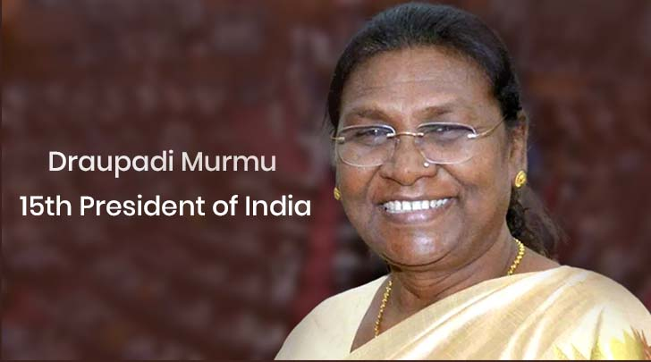
PRESIDENT
The Indian President is the head of the state and he is also called the first citizen of India
He is a part of Union Executive along with the Vice-President, Prime Minister, Council of Ministers, and Attorney-General of India
How president is elected?
There is no direct election for the Indian President. An electoral college elects him. The electoral college responsible for President’s elections comprises elected members of:
Lok Sabha and Rajya Sabha (not the nominated members)
Legislative Assemblies of the states (Legislative Councils have no role)
Legislative Assemblies of the Union Territories of Delhi and Puducherry

Slide 4
TERM OF THE PRESIDENT’S OFFICE
Once President is elected, he holds office for five years. He sits in the office even after the completion of five years given no new election has taken place or no new President has been elected till then.
Qualifications of the President
He/she should be an Indian Citizen
His/her age should be a minimum of 35 years
He/she should qualify the conditions to be elected as a member of the Lok Sabha
He/she should not hold any office of profit under the central government, state government, or any public authority

Slide 5

He/she cannot be a member of Lok Sabha and Rajya Sabha. If he/she has been a member of either of the house, he/she should vacate the seat on his first day as President in the office
He/she should not hold any office of profit
For his/her residence, Rashtrapati Bhavan is provided to him without the payment of rent
Parliament decides his/her emoluments, allowances and privileges
Parliament cannot diminish his emoluments and allowances during his/her term of office
He/she is given immunity from any criminal proceedings, even in respect of his/her personal acts
Arrest or imprisonment of the President cannot take place. Only civil proceedings can be initiated for his personal acts that too after giving two months’ of prior notice.

Slide 6
PROCEDURE FOR IMPEACHMENT OF A PRESIDENT
The only condition for the initiation of impeachment of the Indian president is the ‘violation of the constitution.’
Can the President’s office be vacant?
Yes, his office can be vacant in the following ways:
When the President of India completes his term of five years in the office
If the President resigns by putting forward his resignation to the Vice-President of India
If Lok Sabha/Rajya Sabha initiates an impeachment charge and they stand valid, he is removed
If he dies in the office
If the Supreme Court declares his election invalid

Slide 7
EXECUTIVE POWERS OF PRESIDENT
He may/may not make rules to simplify the transaction of business of the central government
He appoints the attorney general of India and determines his remuneration
He appoints the following people:
Comptroller and Auditor General of India (CAG)
Chief Election Commissioner and other Election Commissioners
Chairman and members of the Union Public Service Commission
State Governors
Finance Commission of India chairman and members
He seeks administrative information from the Union government
He requires PM to submit, for consideration of the council of ministers, any matter on which a decision has been taken by a minister but, which has not been considered by the council
He appoints administrators of union territories
He can declare any area as a scheduled area and has powers with respect to the administration of scheduled areas and tribal areas

Slide 8
LEGISLATIVE POWERS OF PRESIDENT
He summons or prorogues Parliament and dissolve the Lok Sabha
He addresses the Indian Parliament at the commencement of the first session after every general election
He appoints speaker, deputy speaker of Lok Sabha, and chairman/deputy chairman of Rajya Sabha when the seats fall vacant .
He nominates 12 members of the Rajya Sabha
He can nominate two members to the Lok Sabha from the Anglo-Indian Community
He consults the Election Commission of India on questions of disqualifications of MPs.
He recommends/ permits the introduction of certain types of bills (to read on how a bill is passed in the Indian Parliament, check the linked article.)
He promulgates ordinances

Slide 9
FINANCIAL POWERS OF PRESIDENT
To introduce the money bill, his prior recommendation is a must
He causes Union Budget to be laid before the Parliament
To make a demand for grants, his recommendation is a pre-requisite
Contingency Fund of India is under his control
He constitutes the Finance Commission every five years

Slide 10
JUDICIAL POWERS OF PRESIDENT
Appointment of Chief Justice and Supreme Court/High Court Judges are on him
He takes advice from the Supreme Court, however, the advice is not binding on him
He has pardoning power: Under article 72, he has been conferred with power to grant pardon against punishment for an offence against union law, punishment by a martial court, or death sentence.

Slide 11
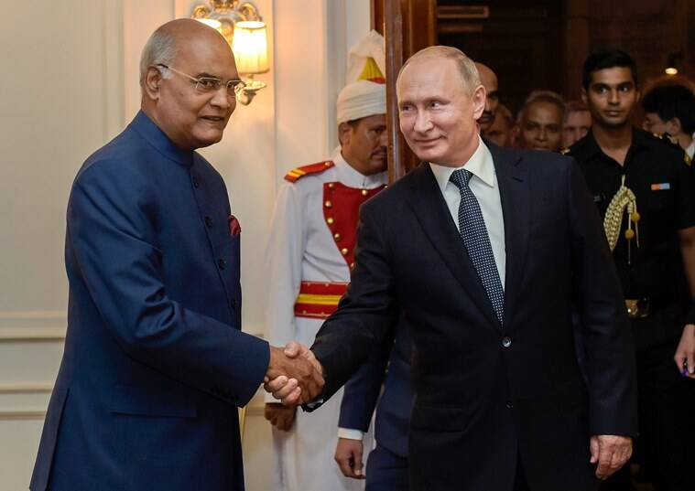
DIPLOMATIC POWERS OF PRESIDENT
International Treaties and agreements that are approved by the Parliament are negotiated and concluded in his name.
He is the representative of India in international forums and affairs

Slide 12
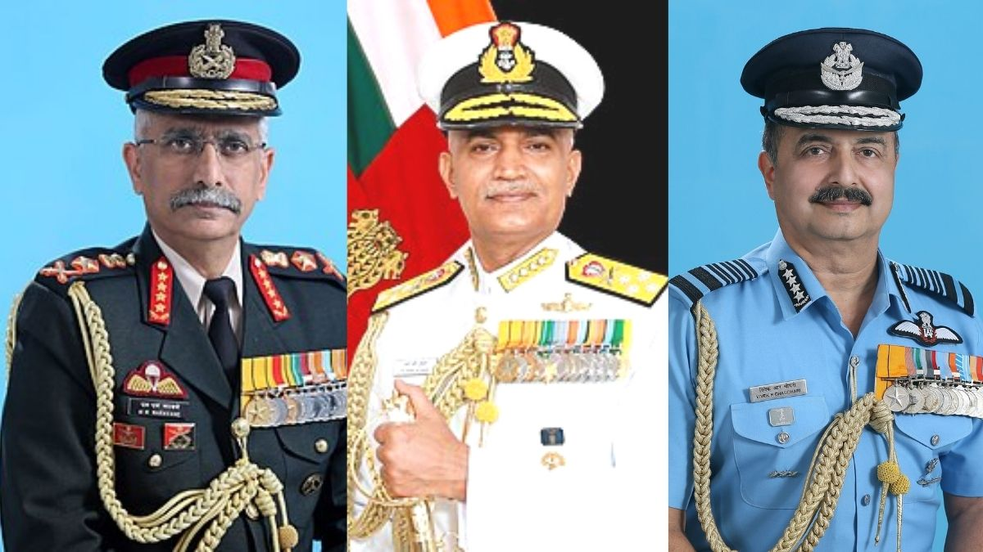
MILITARY POWERS OF PRESIDENT
He is the commander of the defence forces of India. He appoints:
Chief of the Army
Chief of the Navy
Chief of the Air Force

Slide 13
EMERGENCY POWERS OF PRESIDENT
He deals with three types of emergencies given in the Indian Constitution:
National Emergency (Article 352)
President’s Rule (Article 356 & 365)
Financial Emergency (Article 360)

Slide 14
ORDINANCE MAKING POWER OF THE PRESIDENT
Article 123 deals with the ordinance making power of the President.
He promulgates an ordinance on the recommendation of the union cabinet.
VETO POWER OF THE PRESIDENT
When a bill is introduced in the Parliament, Parliament can pass the bill and before the bill becomes an act, it has to be presented to the Indian President for his approval.
It is on the President of India to either reject the bill, return the bill or withhold his assent to the bill.
The choice of the President over the bill is called his veto power. The Veto Power of the President of India is guided by Article 111 of the Indian Constitution.

Slide 15
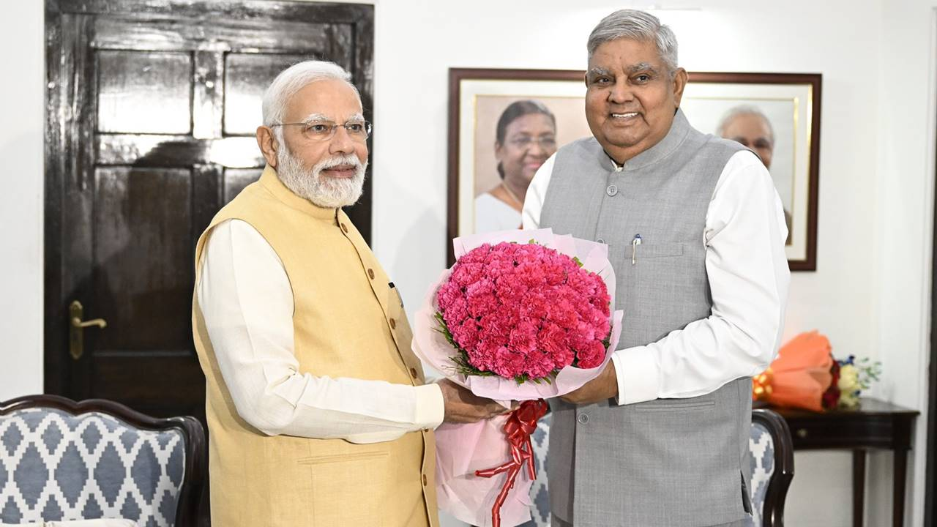
VICE PRESIDENT
The office of Vice-President of India is the second-highest constitutional office in the country
Roles of a vice president
Acts as President in case of Vacancy: Vice-President acts as President when a vacancy occurs in the office of the President due to his-
Resignation,
Removal,
Death or otherwise.
JAGDEEP DHANKAR

Slide 16


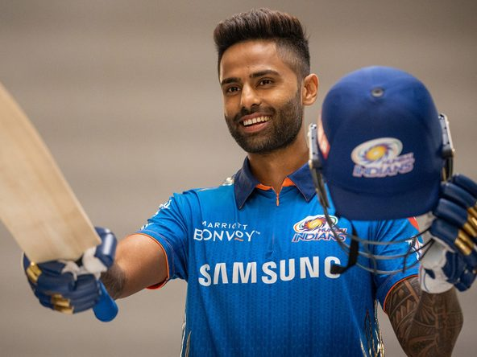



1
2
3
4
6
5

Slide 17
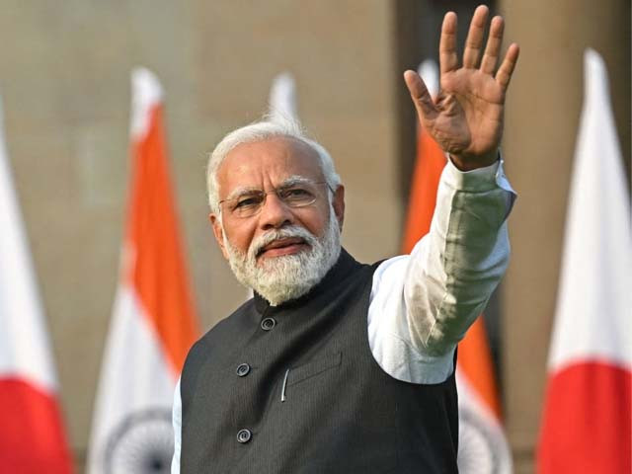
PRIME MINISTER
He is appointed by the President and chosen by the people of India. Prime Minister is the executive head of the State.
The prime minister acts as the leader of the house of the chamber of parliament—generally the Lok Sabha—they belong to. In this role, the prime minister is tasked with representing the executive in the legislature, announces important legislation, and is further expected to respond to the opposition's concerns.

Slide 18
QUALIFICATION OF PRIME MINISTER
He should be a citizen of India
Should not hold any office of profit under government or any public officer.
He should be a member of Lok Sabha or Rajya Sabha
If the candidate is not a member of Lok Sabha or Rajya Sabha at the time of his selection, in that case, he must become a member of Lok Sabha or Rajya Sabha within 6 months.
If he is a member of Lok Sabha, he should be above 25 years of age.
If he is a member of the Rajya Sabha, he should be above 30 years of age.
If any of the candidates for prime minister of India is elected, he must vacate his position in private or public office.

Slide 19
ARTICLE 75 OF THE CONSTITUTION OF INDIA
According to article 75 of the constitution of India, the President of India appoints the prime minister of India after general elections.
After the appointment of the prime minister, the president administers the oath to the prime minister of India before he enters the prime minister’s office.
Once the prime minister of India is appointed, the president will take the advice of the prime minister of India to appoint the council of ministers who will work under the prime minister of India. The total number of the council of ministers including the prime minister should not exceed 15% of the total numbers of Lok Sabha. The president will administer the oath to all the councils of ministers.

Slide 20
TENURE OF THE PRIME MINISTER OF INDIA
There is no fixed term for the prime minister of India, he holds his office as long as his party has the majority in Lok Sabha.
The time period of Lok Sabha is 5 years and after that, there will be general elections in which if his party again gains a majority, then he can continue to hold his office.
The prime minister has to resign during the tenure of the Lok Sabha if he loses the support of the majority during the term of Lok Sabha.
If the prime minister dies or resigns, it will automatically dissolve the council of ministers.
There will be no council of ministers without the prime minister of India. After the death or resignation of the prime minister, the president will nominate the next prime minister who has the majority in Lok Sabha.

Slide 21
EXECUTIVE POWERS OF THE PRIME MINISTER OF INDIA
The councils of ministers are at the top of the executive. The prime minister is the head of the council of ministers. After the elections of Lok Sabha, it is the power of the prime minister that he will advise the President of India to appoint the council of ministers.
After the appointment of the council of ministers, the prime minister will decide the different departments for these ministers.
He can interchange these departments between the ministers anytime.
He can change the decisions of any minister according to the needs of the party.
The PM can ask any of the ministers to give the resign to the president of India.

Slide 22
LEGISLATIVE POWERS OF THE PRIME MINISTER OF INDIA
Prime minister is the head of the council of ministers, so if the prime minister resigns, then the council of ministers cannot make the decisions and it will be dissolved automatically.
If the prime minister thinks that, majority of his party in Lok Sabha has been dissolved, then he can suggest the President dissolve the Lok Sabha and ask for re-election.
It is the prime minister of India who advises the president of India to call the Lok Sabha and Rajya Sabha for their sessions.

Slide 23
MILITARY POWERS OF THE PRIME MINISTER OF INDIA
Prime minister of India is known as the political head of these defence forces.
To implement any strategic policy made by India related to the borders, the prime minister of India can do that by using his military powers.

Slide 24
FUNCTIONS OF THE PRIME MINISTER OF INDIA
Duty to announce important policies- For example, Demonetisation, imposing lockdown
The constitutional obligation of the prime minister- The prime minister must communicate all the decisions or proposals made in the councils of ministers related to the making of new laws or other things to The President
Distribution of work- The prime minister of India helps the president to distribute the work to different ministers
Duty to attend parliamentary sessions- The prime minister of India must attend the parliamentary sessions as a prime minister and give answers to the questions asked by members.
Country representation- The prime minister of India represents our country in high-level meetings and international organizations.

Slide 25
Are the powers of the prime minister of India absolute?
The powers of the prime minister of India depends upon the prevailing political conditions.
Coalition government
Majority government
Key points of the prime minister of India
The Prime minister of India is the link between the President of India and the council of ministers
The Prime minister can select and dismiss the ministers.
He is known as the chairperson of the cabinet
He is the largest influencer over the legislation
He can use his military power to implement any political decision on borders

Slide 26
UNION COUNCIL OF MINISTERS
According to Article 75 of the Indian Constitution, council of ministers are selected by the Prime minister. The President appoints them thereafter. While selecting the ministers, the PM keeps in mind that due representation to different regions of the country, to various religious and caste groups.
Eligibility for being a Union Minister
Member of either of the two Houses of Parliament.

Slide 27
CATEGORIES OF MINISTERS
Cabinet Ministers : The Cabinet Ministers are usually senior members of the party/coalition of parties.
Ministers of State (MoS) : The Ministers of State are ranked next to the Cabinet Ministers. Some of the Ministers of State have independent charge of a department while other Ministers of State only assist the Cabinet Ministers.
Deputy ministers : Deputy ministers are also appointed to assist the Cabinet Ministers or the Ministers of State. No Deputy Minister holds an independent charge of any department. Ministers other than Cabinet Ministers normally do not attend the meetings of the Cabinet. All policy matters are decided by the Cabinet.

Slide 28
DIFFERENCE BETWEEN COUNCIL OF MINISTERS AND CABINET MINISTERS
The Council of Ministers consists of all category of Ministers in the Parliament i.e., Cabinet Ministers and Ministers of State and also Ministers of State with independent charge. The Cabinet on the other hand consists of Senior Ministers only.
The Cabinet varies in number from 15 to 30 while the entire Council of Ministers can consist of even more than 70.
It is the Cabinet that determines the policies and programmes of the Government and not the Council of Ministers.

Slide 29
POWERS AND FUNCTIONS OF THE CABINET
Immense powers and multiple responsibilities.
All the executive powers of the President are exercised by the Cabinet headed by the Prime Minister.
Regulates and formulates the internal and external policies of the country.
It takes all major decisions regarding defense and security of the country.
The Cabinet is also responsible for the Ordinances by the President when the Parliament is not in session.
Forms policies to provide better living conditions for the people.
Cabinet also has control over the national finance.
Responsible for whole of the expenditure of the government as well for raising necessary revenues.
The Cabinet also prepares the agenda of the sessions of the Parliament.

Slide 30
RESPONSIBILITY OF THE COUNCIL OF MINISTERS
Responsibility of the Council of Ministers:
1. Collective Responsibility-
The essence of collective responsibility is that, ‘the Minister must vote with the government, speak in defense of it if the Prime Minister insists, and he/she cannot afterwards reject criticism of his act, either in Parliament or in the constituencies, on the ground that he/she did not agree with the decision. It means that every member of the Council of ministers accepts responsibility for each and every decision of the Cabinet. When a decision has been taken by the Cabinet, every Minister has to stand by it. Also the vote of no-confidence against the Prime Minister is a vote against the whole Council of Ministers.
2. Individual Responsibility-
Individual responsibility is enforced when an action is taken by a Minister without the concurrence of the Cabinet, or the Prime Minister, then it is criticized and not approved by the Parliament. Similarly, if personal conduct of a Minister is questionable, he may have to resign without affecting the fate of the Government.

Slide 31
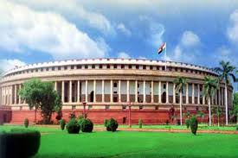
PARLIAMENT
What is Parliament?
The Union government's legislative organ is the Parliament.

Slide 32
Structure of Indian Parliament and Components
As per the constitution, the Indian Parliament is divided into three parts:
The President, the Council of States, and the House of the People.
The Upper House (Second Chamber or House of Elders) is the Rajya Sabha - represents the Indian Union's states and union territories
The Lower House in the Lok Sabha (First Chamber or Popular House)- represents the people of India as a whole

Slide 33
Significance of the Parliament
The Parliament debates matters of national and international importance. In this regard, the opposition plays a vital role in ensuring that the country is aware of alternative opinions.
The parliamentary system of governance allows people from a wide range of ethnic, racial, linguistic, and ideological backgrounds to participate in the formulation of laws and policies.
A Parliament is frequently referred to as a "mini-nation“ and in a democracy, the Parliament is responsible for debating important issues before legislation or resolutions are passed.
The Parliament has the authority to change, reduce, or expand the boundaries of states and UTs.
The House of the People also serves as a source of information. When members of the Houses demand information, ministers are obligated to disclose it.

Slide 34
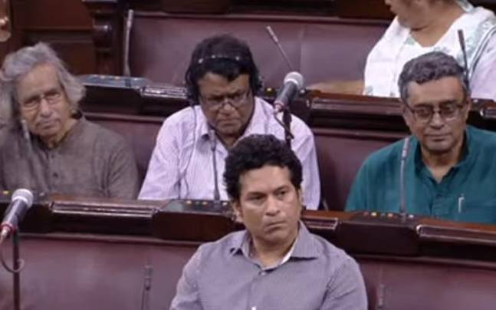
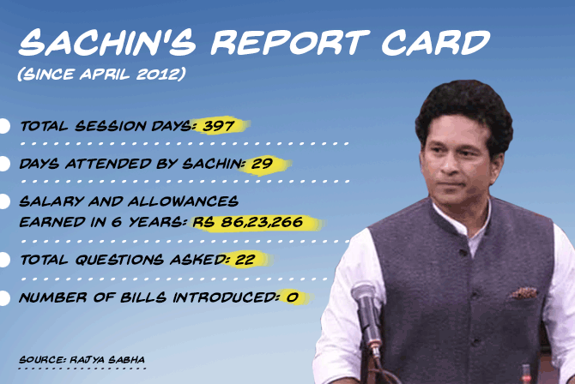
Member of Rajya sabha
2012-2017

Slide 35
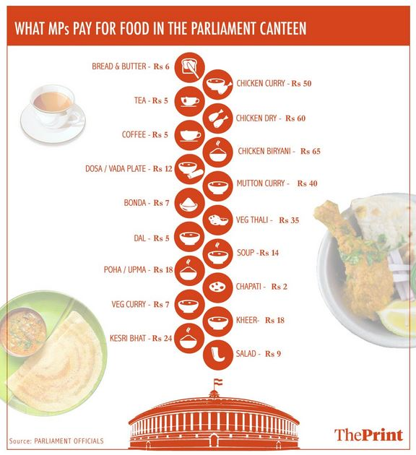

Slide 36
PARLIAMENTARY COMMITTEE
Types of Committees | Categories of Committees | Sub-Categories of Committees
Standing Committees | Financial Committees | Public Accounts Committee Estimates Committee Committee on Public Undertakings
 | Departmental Standing Committees | Total-24 (Read the article below to know the names of the departmental committees)
 | Committees to Inquire | Committee on Petitions Committee of Privilege Ethics Committee
 | Committees to Scrutinise and Control | Committee on Government Assurances Committee on Subordinate Legislation Committee on Papers Laid on the Table Committee on Welfare of SCs and STs Committee on Empowerment of Women Joint Committee on Offices of Profit

Slide 37
PARLIAMENTARY COMMITTEE
Types of Committees | Categories of Committees | Sub-Categories of Committees
Standing Committees | Committees Relating to the Day-to-Day Business of the House | Business Advisory Committee Committee on Private Members’ Bills and Resolutions Rules Committee Committee on Absence of Members from Sittings of the House
 | House-Keeping Committees or Service Committees | General Purposes Committee House Committee Library Committee Joint Committee on Salaries and Allowances of Members

Slide 38
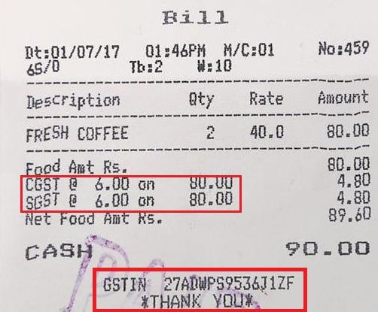
CENTER-STATE RELATION
Legislative relations - Articles 245 to 255 deal with legislative relations between the Union and the states i.e. the Parliament and state legislatures. It discusses the extent of law-making powers given to the Union and states.
Administrative relations - Articles 256 to 263 deal with administrative relations i.e. Central Government and various state governments.
Financial relations - Articles 264 to 293 of Part XII of the Constitution deal with financial relations between the Centre and state. A very recent example of financial centre-state relation is the Goods and Services Tax which is a dual structure tax. The tax is imposed and collected by both the Centre and state and then is distributed between the Centre and states.

Slide 39
Constitutional provisions relating to centre-state relations
Article 246
The provision deals with the subject matters on which the Centre and states can make laws.
Article 270
This provision deals with levying and distribution of taxes between the Centre and the states. These include those taxes which are collected by the Central Government in accordance with List-I. It prescribes for the formation of a Finance Commission and distribution of such percentage to every state as may be discussed by the commission.
Article 246A, Article 269A
The provision relates to GST. No authority had the power to levy GST since the same was not mentioned in the Seventh Schedule. Therefore, by the 101st Constitution Amendment Act, 2016, GST was made valid.
Article 256
This provision makes it an obligation on part of the state governments to ensure compliance with laws made by the Parliament and also gives power to the Central Government to give directions to states as it may deem necessary
Article 258
The provision empowers the Centre to confer and entrust powers to a state even in matters where the Union has executive powers.

Slide 40
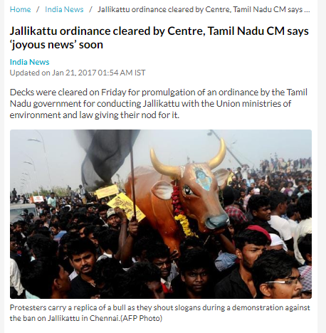
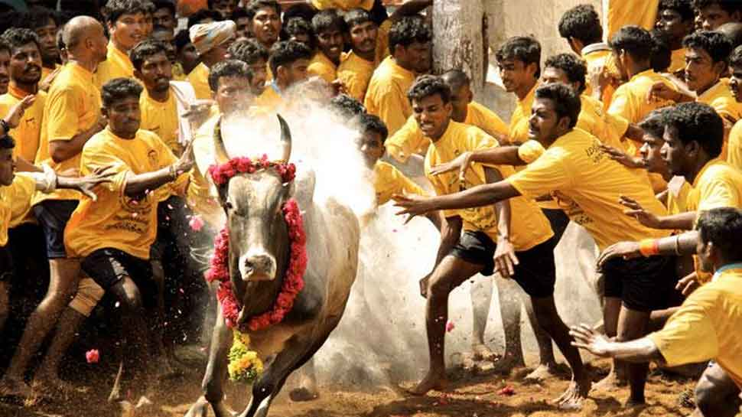
IMPACT ON GOOD GOVERNANCE
A step towards cooperative federalism- Trust and faith between the Centre and states. Separation of powers on different matters
Harmony between Centre and states- The powers of the Centre and states have already been distinguished by the Indian Constitution. This would result in a streamlined mechanism where the states would not try to exceed their jurisdiction
Better role of states- States are empowered to make their own laws in accordance with the State List.

Slide 41
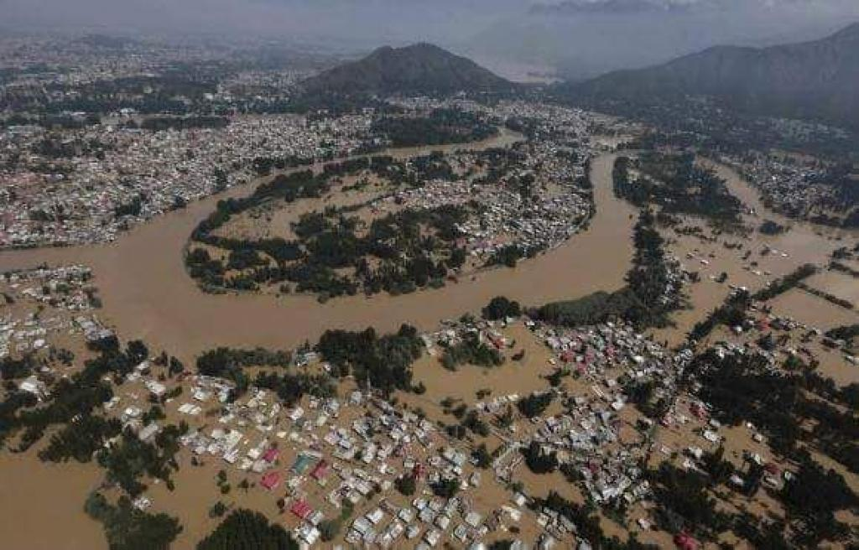
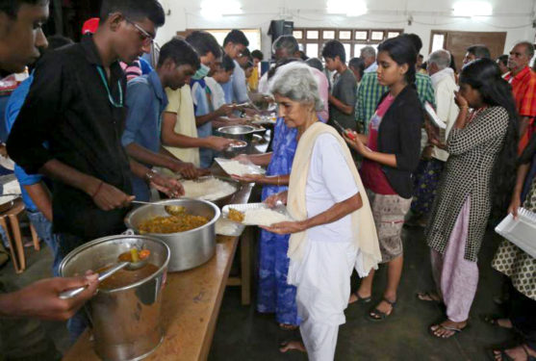
IMPACT ON GOOD GOVERNANCE
Lesser burden on the Centre- Moreover, the states would be able to handle the situation better, however, the Centre might not be ready to accept so many regional disparities. Example, flood control by Govt. of kerala

Slide 42
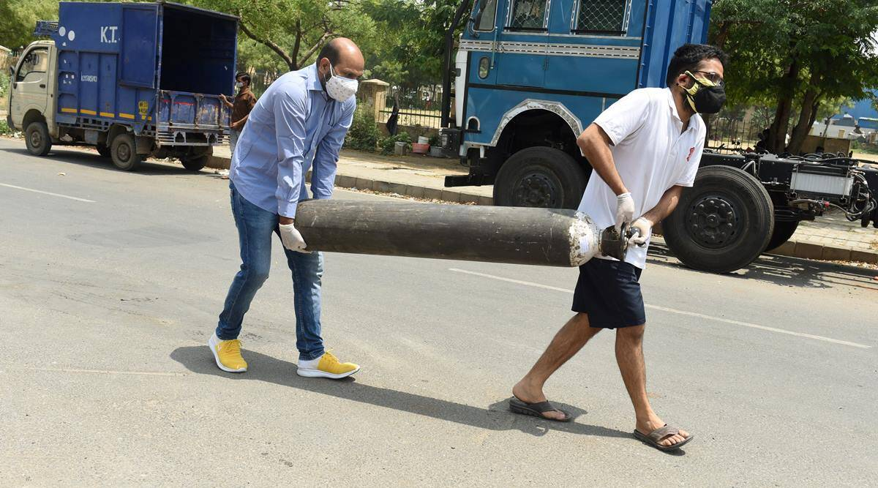
IMPACT OF COVID-19 ON CENTRE-STATE RELATIONS
In terms of administrative relations, many states felt that there has been discrimination by the Centre in terms of distributing medical equipment and vaccines, though the truth cannot be established. Further, as regards the legislative relations, states were not consulted in many matters which were stipulated in the statutes; they were bound to follow the orders of the Centre which strained the relations between the Centre and states.

Slide 43
UNION JUDICIARY – SUPREME COURT OF INDIA
It is the final court of appeal in the country
The Constitution of 1950 envisaged a Supreme Court with one Chief Justice and 7 puisne Judges. The number of SC judges was increased by the Parliament and currently, there are 34 judges including the Chief Justice of India (CJI).

Slide 44
Supreme Court of India – Functions
It takes up appeals against the verdicts of the High Courts, other courts and tribunals.
It settles disputes between various government authorities, between state governments, and between the centre and any state government.
It also hears matters which the President refers to it, in its advisory role.
The SC can also take up cases suo moto (on its own).
The law that SC declares is binding on all the courts in India and on the Union as well as the state governments.

Slide 45
SUPREME COURT COMPOSITION
Including the CJI, there are 34 judges in the Supreme Court.
The judges sit in benches of 2 or 3 (called a Division Bench) or in benches of 5 or more (called a Constitutional Bench) when there are matters of fundamental questions of the law is to be decided.

Slide 46
The Procedure of the Supreme Court of India
The Supreme Court of India has powers to consult the President to regulate the practice and procedure of the Court. The Constitutional Cases are usually decided by a bench consisting of five judges whereas other cases are decided by a bench of at least three judges.
As per the Constitution of India, Delhi is declared as the seat of the Supreme Court of India. However, the Chief Justice of India has the power to assign another place (s) as the seat of the Supreme Court. This is only an optional provision and not mandatory.
The seat of Supreme Court

Slide 47
SC Judge Eligibility
As per Article 124, an Indian citizen who is below 65 years of age is eligible to be recommended for appointment as a judge of the SC if:
he/she has been a judge of one or more High Courts, for at least 5 years, or
he/she has been an advocate in one or more High Courts for at least 10 years, or
he/she is in the opinion of the President, a distinguished jurist.

Slide 48
Independence of Judiciary
Security of tenure: The judges of the SC are given security of tenure. Once appointed, they will retain their office until the age of 65 years. They can be removed only by a presidential order on grounds of proven misbehaviour and/or incapacity.
Salaries and allowances: The judges of the SC enjoy good salaries and allowances and these cannot be decreased except in the case of a financial emergency.
Powers and Jurisdiction: The SC’s powers and jurisdiction can only be added by the Parliament and not be curtailed. The conduct of any judge of the Supreme Court in the discharge of his/her duties cannot be discussed in the legislature. The SC has the power to punish any person for its contempt, as per Article 129. (Read about Contempt of Court in India in the linked article.)
Separation of the Judiciary from the Executive: A Directive Principle of State Policy says that the state shall take steps to separate the judiciary from the executive in the public services of the state. According to Article 50, there shall be a separate judicial service free from executive control.

